Slide 1
FunKey Coupling Matrix Old
 | Key Drivers
 | Raw Material Order | Product Delivery Pattern | Quality | Financial Model | Efficiency | iFEM Analysis | Workforce Required | Waste Produced | Floorplan | Reliability
F1 | X | X |  |  | X |  | X | X | X | X
F2 |  |  |  |  |  |  | X |  | X
F3 | X | X |  | X |  |  |  | X | X | X
F4 | X |  |  |  | X |  |  |  | X | xx
F5 |  |  |  | X |  |  |  |  |  | X
F6 |  |  | X |  | X | X |  | X
F7 | X |  | X |  |  |  |  |  |  | X
Functions
F1 : Sequence & Schedule Production to meet deadlines
F2 : Decide Machinery Requirements
F3 : Plan & Order Inventory
F4 : Generate Floorplan (Production System Layout)
F5 : Generate Financial Model
F6 : Calculate System & Product Performance
F7 : Carry out FMEA

Slide 2
FunKey Coupling Matrix - New
 | Key Driver
 | kd1 | kd2 | kd3 | kd4 | kd5 | kd6 | kd7 | kd8
F1 | X |  | X |  | X | X | X
F2 | X |  |  |  | X | X | X
F3 | X |  |  | X | X
F4 | X | X |  |  | X |  |  | X
F5 | X | X | X | X | X | X |  | X
Function
F1 : Sequence & Schedule Production
F2 : Manage Inventory
F3 : Monitor Finance
F4 : Generate Production System Layout
F5 : Monitor Production
kd1 : Raw Material Order Pattern
kd2 : Floorplan
kd3 : Efficiency
kd4 : Financial Forecast
kd5 : Product & Production Quality
kd6 : Order Delivery
kd7 : iFEM Analysis
kd8 : Legality & Sustainability

Slide 3
Verification Matrix - New
 | Test Protocol 1
 | T1 | T2 | T3 | T4 | T5
1.1
1.2
1.3
2.1
3.1
3.2
4.1
4.2
4.3
5.1
5.2
6.1
6.2
6.3
6.4
6.5
KPIs

Slide 4
Test Protocol 1 | Functional KPI
 | 1.1, 1.2, 3.1, 3.2, 5.1 | 1.3, 4.1, 8.1, 5.2 | 4.2, 4.3, 6.1, 6.2 | 6.3, 6.4, 6.5, 7.1, 7.2 | 2.1
Test 1: Documentation Check | X
Test 2: Floor Inspection |  | X
Test 3: Efficiency Check |  |  | X
Test 4: Quality Check |  |  |  | X
Test 5: Waste Check |  |  |  |  | X

Slide 5
 | Functional KPI
kd | 1 |  |  | 2 | 3 |  | 4 |  |  | 5 |  | 6 |  |  |  |  | 7 |  | 8
kpi | 1.1 | 2 | 3 | 1 | 1 | 2 | 1 | 2 | 3 | 1 | 2 | 1 | 2 | 3 | 4 | 5 | 1 | 2 | 1
T1 | X | X |  |  | X | X |  |  |  |  | X
T2 |  |  | X |  |  |  | X |  |  |  | X |  |  |  |  |  |  |  | X
T3 |  |  |  |  |  |  |  | X | X |  |  | X | X
T4 |  |  |  |  |  |  |  |  |  |  |  |  |  | X | X | X | X | X
T5 |  |  |  | X
Tests
Test Protocol 1 : Unit Testing
[T1] Test 1 : Documentation Checl
[T2] Test 2 : Floor Inspection
[T3] Test 3 : Efficiency Check
[T4] Test 4 : Quality Check
[T5] Test 5 : Waste Check

Slide 6
 | Functional KPI
kd | 1 |  |  | 2 | 3 |  | 4 |  |  | 5 |  | 6 |  |  |  |  | 7 |  | 8
kpi | 1 | 2 | 3 | 1 | 1 | 2 | 1 | 2 | 3 | 1 | 2 | 1 | 2 | 3 | 4 | 5 | 1 | 2 | 1
T1 | X | X |  |  | X | X |  |  |  |  | X
T2 |  |  | X |  |  |  | X |  |  |  | X |  |  |  |  |  |  |  | X
T3 |  |  |  |  |  |  |  | X | X |  |  | X | X
T4 |  |  |  |  |  |  |  |  |  |  |  |  |  | X | X | X | X | X
T5 |  |  |  | X
Tests
Test Protocol 1 : Unit Testing
[T1] Test 1 : Documentation Check
[T2] Test 2 : Floor Inspection
[T3] Test 3 : Efficiency Check
[T4] Test 4 : Quality Check
[T5] Test 5 : Waste Check
Test Protocol 2: Integration Testing | Non Functional KPI
Virtual Environment Testing & Real life Monitoring | Efficiency, Reliability, Flexibility, Cost Effectiveness

Slide 7
Key Driver | Functional KPI
1. Law Compliance | 1.1 Standard Working hours 2 shifts/day, 48 weeks/year 1.2 Minimum Working wage 1.3 Safety exits at least 0.7 m wide
2. Sustainability | 2.1 Less than 5% wasted product and material
3. Financial Forecast | 3.1 Cost of new machines < €40, 000 3.2 Breakeven point reached in 5 years
4. Product Flow | 4.1 Walking distance < 2 m 4.2 Product Transit Time/Production Time < 0.13 4.3 Total idle time < 10% of the total production time
5. Raw Material Order Pattern | 5.1 Regular and reliable raw material order patterns with a < 10% variation 5.2 Safety Stock < 5%, ordered raw materials left unused < 5%
6. Production Quality | 6.1 OEE >= 90% overall 6.2 Cpk > 1.5 6.3 Machine startup defects < 1% per machine 6.4 Average scrap < 5% per machine 6.5 Downtime < 8 hours
7. Product Quality | 7.1 No. of defective products per batch / total products per batch < 0.02 7.2 For the STS cranes horizontal displacement of boom tip <= 4mm
8. Order Delivery | 8.1 Orders should be ready at least 1 day before the required delivery date
Non Functional KPI:
Efficiency
Reliability
Flexibility
Maintainability
Cost Effectiveness

Slide 8
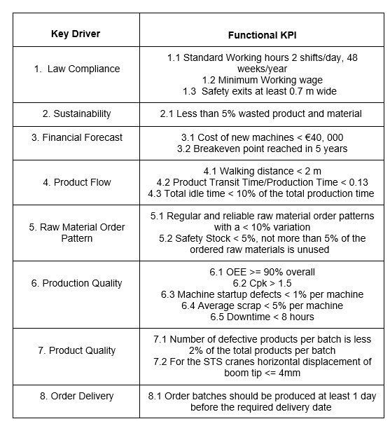
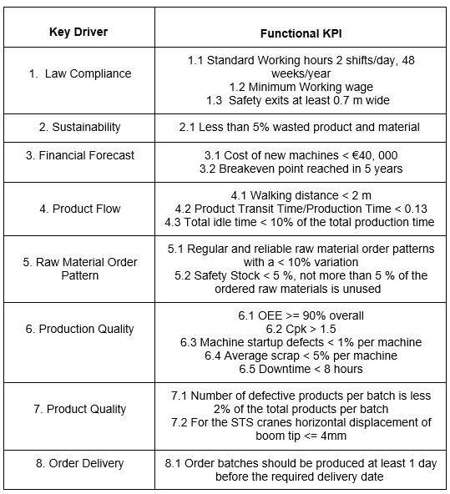

Slide 9
F1 : Place Order
F2 : Accept Order
F3 : Consolidate Machine Availability
F4 : Schedule Production
F5 : Maintain Inventory
F6 : Monitor Finances & Buy Supplies
F7 : Create Floorplan
F8 : Monitor Production
F9 : Build Production System
F10 : Buy Manufactured Products
F11 : Sell Supplies
F12 : Invest Capital

Slide 10
F2 |  |  | X |  | X
 | F3 |  | X
 |  | F9
 |  |  | F4 | X |  | X | X
 |  |  |  | F5 | X | X | X
 |  |  |  | X | F6 |  |  |  |  |  | X
 |  | X |  |  |  | F7 | X
 |  |  | X |  |  |  | F8
X |  |  |  |  |  |  |  | F1
 |  |  |  |  |  |  |  |  | F10
 |  |  |  |  |  |  |  |  |  | F12
 |  |  |  |  |  |  |  |  |  |  | F11

Slide 11
Functional N² Diagram
 | X |  |  |  |  |  | X
 | F1 | X | X | X |  | X | X
 | X | F2 |  | X | X
X | X |  | F3 | X | X |  | X
X |  |  |  | F4 | X | X
X |  |  |  |  | F5
 |  |  |  |  |  | F6
 | X |  |  |  |  |  | F7
F1 : Sequence & Schedule Production to meet deadlines
F2 : Decide Machinery Requirements
F3 : Plan & Order Inventory
F4 : Generate Floorplan (Production System Layout)
F5 : Generate Financial Model
F6 : Calculate System & Product Performance
F7 : Carry out FMEA

Slide 12
Functional N² Diagram
 | X
 | F1 | X | X |  | X | X | X
 | X | F2 | X | X
X |  |  | F4 | X |  | X
X |  |  |  | F5
X | X |  | X | X | F3 |  | X
 |  |  |  |  |  | F6
X | X |  |  |  |  |  | F7
F1 : Sequence & Schedule Production to meet deadlines
F2 : Decide Machinery Requirements
F3 : Plan & Order Inventory
F4 : Generate Floorplan (Production System Layout)
F5 : Generate Financial Model
F6 : Calculate System & Product Performance
F7 : Carry out FMEA

Slide 13
Functional N² Diagram
 | X
 | F1 | X | X |  | X | X | X
 | X | F2 | X | X
X |  |  | F4 | X |  | X
X |  |  |  | F5
X | X |  | X | X | F3 |  | X
 |  |  |  |  |  | F6
X | X |  |  |  |  |  | F7
F1 : Sequence & Schedule Production to meet deadlines
F2 : Decide Machinery Requirements
F3 : Plan & Order Inventory
F4 : Generate Floorplan (Production System Layout)
F5 : Generate Financial Model
F6 : Calculate System & Product Performance
F7 : Carry out FMEA

Slide 14
Functional N² Diagram
 | X
 | F1 | X | X |  | X | X | X
 | X | F2 |  | X | X
X | X |  | F3 | X | X |  | X
X |  |  |  | F5
X |  |  |  | X | F4 | X
 |  |  |  |  |  | F6
X | X |  |  |  |  |  | F7
F1 : Sequence & Schedule Production to meet deadlines
F2 : Decide Machinery Requirements
F3 : Plan & Order Inventory
F4 : Generate Floorplan (Production System Layout)
F5 : Generate Financial Model
F6 : Calculate System & Product Performance
F7 : Carry out FMEA

Slide 15
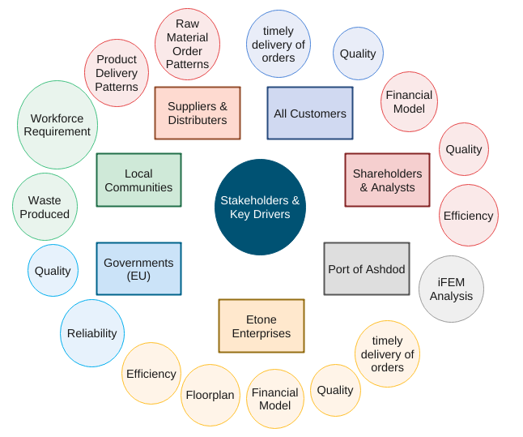
Stakeholders & Key Drivers

Slide 16
N² Architecture
Etone |  | 2 |  |  | 3
 | Factory |  |  |  | 13 |  | 11
 |  | PP&C | 4 | 4 | 4
7 |  |  | PFD | 6 | 7
8 |  |  | 5 | F&IM | 5 | 8 | 5
9 |  | 14 |  |  | QC&RM | 9
1 |  |  |  | 12 | 13 | Stake- holders
 | 10 |  |  |  | 13 | 11 | Suppliers & Distributors
Subsystem Abbreviations :
PP&C : Production Planning & Control
PFD : Production Flow Design
F&IM : Finance & Inventory Management
QC&RM : Quality Control & Risk Mitigation
The orange interfaces are Materials. This includes :
Raw Material
Manufactured Product
The other interfaces are Information. This includes :
Inventory Plans, Order Plan,
Assets and Inventory
Requirements
Performance Reports, Financial Plans
Production System Layout
The green interfaces are information interfaces activated when a failure occurs. This includes :
Lack of workforce on certain days
Lack of inventory
Unexpected Machine Failure
1. Product Order
2. Order Forecast, Existing Machine Data.
3. Performance Requirements
4. Production Sequence & Schedule
5. Inventory & Order (Machinery, Delivery etc.) Plan
6. Land & Resource Requirements
7. Factory Layout
8. Financial Projections
9. System & Product Performance
10. Raw Material
11. Manufactured Product
12. Revenue
13. Failure
14. Risk & Maintenance Protocol

